Slide 1
Quantitative Data
Random Variable (RV). An experimental outcome that generates exactly one numerical value. For example, the number of automobiles sold during one day at a car dealership has the random variable X = Number of cars sold. X represents one particular outcome for an experiment. Random variables can be either discrete, or continuous.
Discrete Random Variable. The random variable is a countable number, such as {0,1,2,3, …}.
Continuous Random Variable. The random variable has an uncountable number of possible outcomes. CRV’s are real numbers.

Slide 2
Binomial Probability Distribution
(Discrete Distribution)
Notes:
See p. 88.

Slide 3
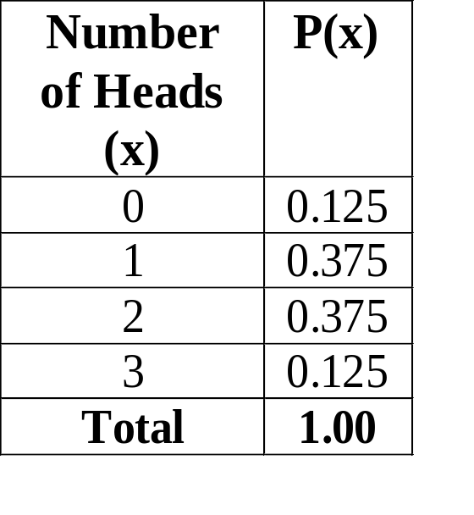

Example
Consider a random experiment in which 3 coins are tossed in each trial. Let x be the number of heads in each trial. Let H represent the outcome of a head and T the outcome of a tail.
n = 3
P(S) = 0.50
E(x) = 0(.125) + 1(.375) + 2(.375) + 3(.125) = 1.5

Slide 4
Binomial Probability Distribution
Terminology
A binomial experiment is an experiment that satisfies the following conditions:
  There are only 2 possible outcomes for each trial, Success (S) or Failure (F).
  There are a fixed number of independent trials n.
  The probabilities do not change for each trial.
Notes:
Where:
N = # independent trials.
X = Outcome of a trials (S or F).
p = Probability of success on each trial.
N = Fixed number of trials. N must be fixed since P(X) will change constantly depending on the size of the experiment. For instance, if you flip a coin 10 times the expected number of heads might be X=5, and P(X<5) = 38%. But if you flip it 100 times then P(X<5) = 0%. So for N=100 P(X<5) = 0%, while for N=10 P(X<5) = 38%.
All Trials Are Independent. The flipping of one coin has absolutely nothing to do with the outcome of any other flip. It still has a 50% probability of coming up heads on the next flip. Card example - we determine P(K), and then immediately try to determie the P(Q|K). This trial depends on what we picked up on the first draw ==> There is no replacement.
p = Probabilities Do Not Change For Each Trial. Again, the trials are independent. We also have sampling with replacement - The probability of each trial would change if we did not replace the sampled item. For example, if a jar contains 2 red marbles and 2 green marbles, the probability of picking a green marble would change if we sampled 1 in 4 marbles, then went back and picked another marble without replacing the first one.
Only 2 Possible Outcomes For Each Trial, Success (S) or Failure (F). We do not have the possibility of more than 2 outcomes, such as: Experiment of asking the type of music preferred (country P(C), gospel P(G), rock P(R), jazz P(J)). However, it would be binomial if you asked someone if they liked the style of music you play for them (yes or no).

Slide 5
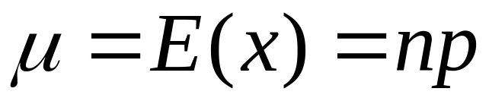
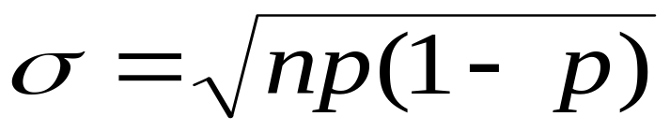
Binomial Probability Distribution
Mean & Standard Deviation
x = {0,1, …n}
n = number of trials.
  p = probability of success on each trial.
  x = number of successes in n trials.
Notes:
EXAMPLE:
In Seattle 73% of the days in a year are cloudy. Find the mean and standard deviation of the number of cloudy days during the month of April.
n=30; p=.73;
E(x) = np = 30(.73) = 21.9
SD = sqrt(np(1-p)) = sqrt(30*.73*.27) = 2.43
We will see later that this curve is approximately normal.

Slide 6
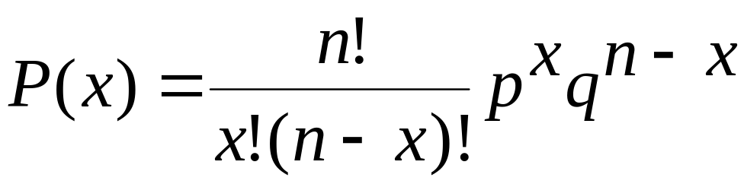
Binomial Probability Distribution
Binomial Equation
x = {0,1, …n}
  n = number of trials.
  p = probability of success on each trial.
  x = number of successes in n trials.
  P(x) = probability of x successes in n trials.
See tables in back of book, Page T-3
Binompdf (n, p, x)
Binomcdf (n, p, x)
Notes:
Where:
n factorial is n! = n(n-1)(n-2) … (2)(1)
So, 4! = 4*3*2*1 = 24
And the special case where 0! = 1
EXAMPLE work out this example on board:
A fair coin is tossed 3 times. What is the probability of rolling exactly 2 out of 3 heads in a row?
N = 3; P = .5; X = 2 (answer = .375)
You can also solve this problem using the tables in the back of the book (P.485 - Appendix A), or by using a calculator such as the TI-83. Any method is fine.
A telemarketer gets 5 sales for every 100 phone calls made. p = .05; N=100
The probability of getting 5 “1’s” in a row when rolling a die 10 times.
The probability of a pregnant woman having a girl is p = .5

Slide 7
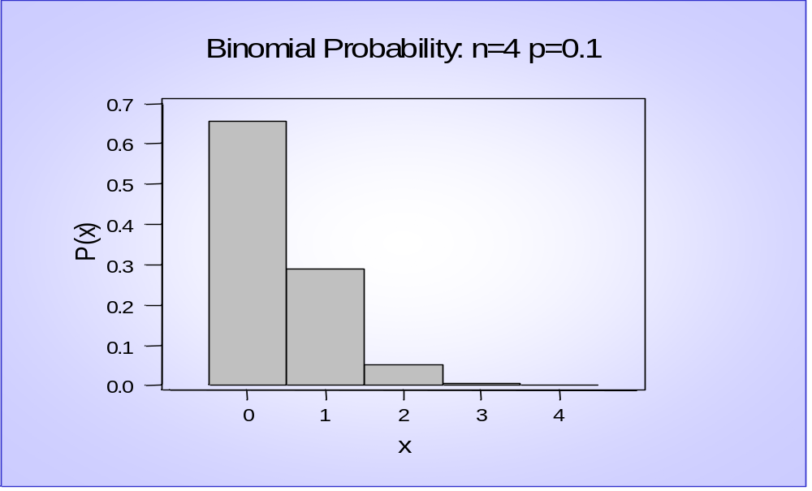

Slide 8
Binomial Probability Distribution
n = 4; p = .9
0 1 2 3 4
(Graphic is flipped 180 degrees)

Slide 9



Shape of the Binomial Distribution
p = 0.1
p = 0.3
p = 0.5
B
i
n
o
m
i
a
l
P
r
o
b
a
b
i
l
i
t
y
:
n
=
4
p
=
0
.
1
B
i
n
o
m
i
a
l
P
r
o
b
a
b
i
l
i
t
y
:
n
=
4
p
=
0
.
3
B
i
n
o
m
i
a
l
P
r
o
b
a
b
i
l
i
t
y
:
n
=
4
p
=
0
.
5
0
.
7
0
.
7
0
.
7
0
.
6
0
.
6
0
.
6
n = 4
)
0
.
5
)
0
.
5
)
0
.
5
x
0
.
4
x
0
.
4
x
0
.
4
(
(
(
P
0
.
3
P
0
.
3
P
0
.
3
0
.
2
0
.
2
0
.
2
0
.
1
0
.
1
0
.
1
0
.
0
0
1
2
3
4
0
.
0
0
1
2
3
4
0
.
0
0
1
2
3
4
x
x
x
B
i
n
o
m
i
a
l
P
r
o
b
a
b
i
l
i
t
y
:
n
=
1
0
p
=
0
.
1
B
i
n
o
m
i
a
l
P
r
o
b
a
b
i
l
i
t
y
:
n
=
1
0
p
=
0
.
3
B
i
n
o
m
i
a
l
P
r
o
b
a
b
i
l
i
t
y
:
n
=
1
0
p
=
0
.
5
0
.
5
0
.
5
0
.
5
n = 10
0
.
4
0
.
4
0
.
4
)
0
.
3
)
0
.
3
)
0
.
3
x
x
x
(
(
(
P
0
.
2
P
0
.
2
P
0
.
2
0
.
1
0
.
1
0
.
1
0
.
0
0
1
2
3
4
5
6
7
8
9
1
0
0
.
0
0
1
2
3
4
5
6
7
8
9
1
0
0
.
0
0
1
2
3
4
5
6
7
8
9
1
0
x
x
x
B
i
n
o
m
i
a
l
P
r
o
b
a
b
i
l
i
t
y
:
n
=
2
0
p
=
0
.
1
B
i
n
o
m
i
a
l
P
r
o
b
a
b
i
l
i
t
y
:
n
=
2
0
p
=
0
.
3
B
i
n
o
m
i
a
l
P
r
o
b
a
b
i
l
i
t
y
:
n
=
2
0
p
=
0
.
5
n = 20
)
0
.
2
)
0
.
2
)
0
.
2
x
x
x
(
(
(
P
0
.
1
P
0
.
1
P
0
.
1
0
.
0
0
1
2
3
4
5
6
7
8
9
1
0
1
1
1
2
1
3
1
4
1
5
1
6
1
7
1
8
1
9
2
0
0
.
0
0
1
2
3
4
5
6
7
8
9
1
0
1
1
1
2
1
3
1
4
1
5
1
6
1
7
1
8
1
9
2
0
0
.
0
0
1
2
3
4
5
6
7
8
9
1
0
1
1
1
2
1
3
1
4
1
5
1
6
1
7
1
8
1
9
2
0
x
x
x
Binomial distributions become more symmetric as n increases and as p .5.

Slide 10
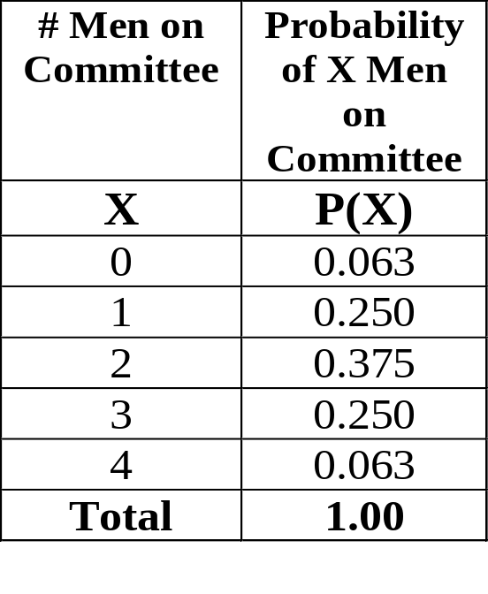
Binomial Probability Distribution
Common Error- Thinking that the “most likely” outcome is the outcome that will occur “more than half of the time”.
Example: Randomly choose a committee of 4 people from the entire US population. So n = 4; P(man) = 0.5. The most likely configuration therefore will be that of 2 men and 2 women.
Although the most likely outcome is 2 men and 2 women, it occurs only 37.5% of the time.
Furthermore, the configuration of 3 men and 1 woman, or 3 women and 1 man occurs 50% of the time.
Notes:
Where:
EXAMPLE:
In Seattle 73% of the days in a year are cloudy.Find the mean and standard deviation of the number of cloudy days during the month of April.
n=30; p=.73;
E(x) = np = 30(.73) = 21.9
SD = sqrt(np(1-p)) = sqrt(30*.73*.27) = 2.43

Slide 11
Normal Probability Distribution
(Continuous Distribution)
Notes:
See p. 88.

Slide 12
Characteristics of a Normal Distribution
r
a
l
i
t
r
b
u
i
o
n
:
μ
=
0
,
σ²
=
1
0
.
4
Normal
curve is
symmetrical
0
.
3
0
.
2
Theoretically,
curve
extends to
infinity
x
(
f
0
.
1
.
0
-
5
a
Mean, median, and
mode are equal
x
The area under the curve equals 100%.

Slide 13
The Normal Distribution
Many natural phenomena are normally distributed, such as:
- the heights of all people in the world, country.
- the life of an energizer battery.
- the weights of cereal in each box of frosted flake.
Notes:
Think of this as a frequency distribution with many bars.
Give a few graphical examples.

Slide 14
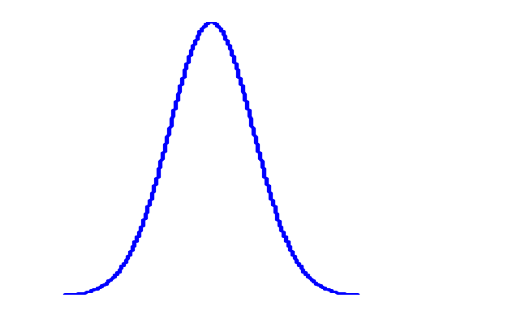

Means and Standard Deviations
Curves with different means, same standard deviation
10
11
12
13
14
15
16
17
18
19
20
Curves with different means different standard deviations
9
10
11
12
13
14
15
16
17
18
19
20
21
22

Slide 15
Empirical Rule (68-95-99.7%)
Data with symmetric bell-shaped distribution has the following characteristics.
13.5%
13.5%
68%
4
3
2
1
0
1
2
3
4
About 68% of the data lies within 1 standard deviation of the mean
About 95% of the data lies within 2 standard deviations of the mean
About 99.7% of the data lies within 3 standard deviations of the mean

Slide 16
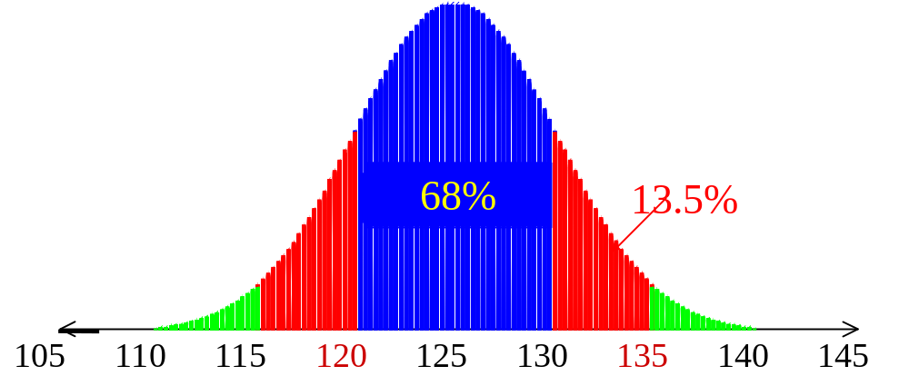
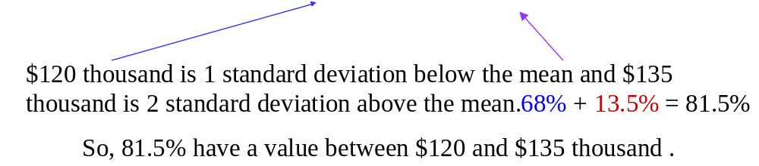
The mean value of condos on a street is $125 thousand with a standard deviation of $5 thousand. The data set has a bell shaped distribution. Estimate the percent of condos between $120 and $135 thousand:

Slide 17
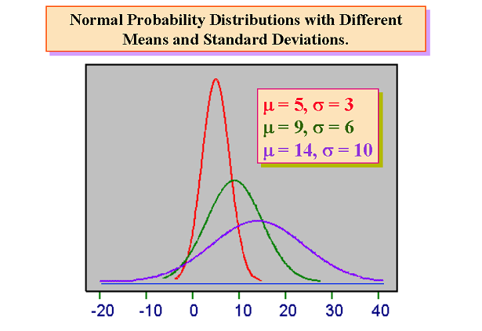
Normal Distribution

Slide 18
Normal Distribution

Slide 19
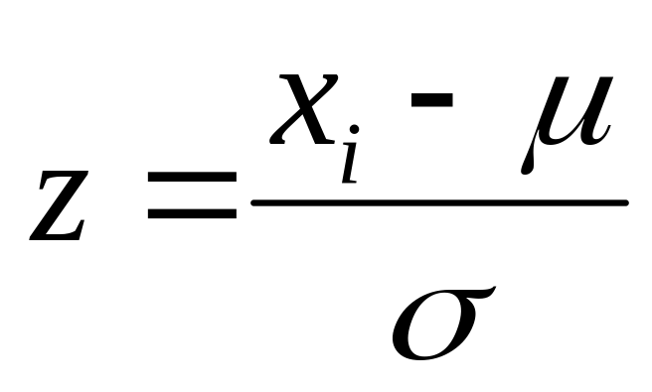
Z Score
Z Score (Standard Score). The normalized value of standard deviations that a given value x falls from the mean.
Notes:
Draw this example graphically.
EXAMPLES:
We need to normalize because:
It’s king of like normalizing when you convert to percentiles, like when an exam where you get 19/25 (76%), and then another exam where you get 78/90 (87%).
Contrast a 5 year old girl’s height with that of her peers (classmates). How far from the norm is she for her age? Then contrast her mothers height with her peers (other adults). How far from the norm is she?
Contrast an 8 year old boy’s IQ test with that of a 35 year old math PhD.

Slide 20
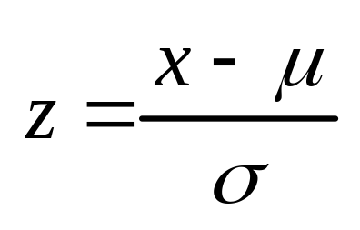
Z Score
Z Score (Standard Score). The normalized value of standard deviations that a given value x falls from the mean.
Example. Suppose a student gets a 73 out of 100 (73%) on a statistics test, and a 26 out of 30 (87%) on a biology test. Which test is score is higher?
Hint:
the mean and standard deviation for the statistics test was 63 and 7.0, respectively.
the mean and standard deviation for the biology test was 23 and 3.9, respectively.
Notes:
Draw this example graphically.
EXAMPLES:
We need to normalize because:
It’s king of like normalizing when you convert to percentiles, like when an exam where you get 19/25 (76%), and then another exam where you get 78/90 (87%).
Contrast a 5 year old girl’s height with that of her peers (classmates). How far from the norm is she for her age? Then contrast her mothers height with her peers (other adults). How far from the norm is she?
Contrast an 8 year old boy’s IQ test with that of a 35 year old math PhD.

Slide 21
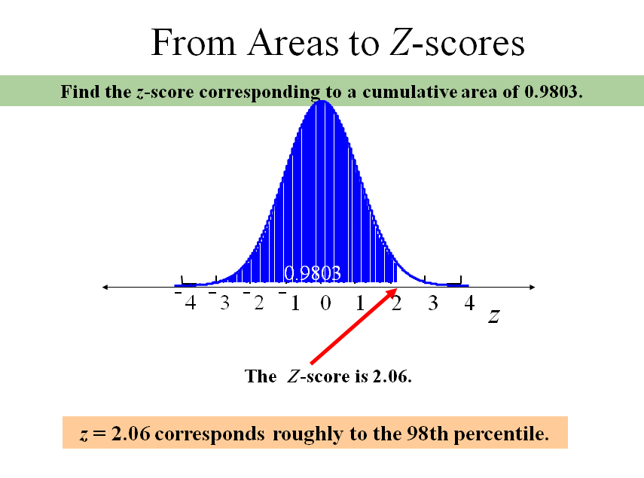

Slide 22
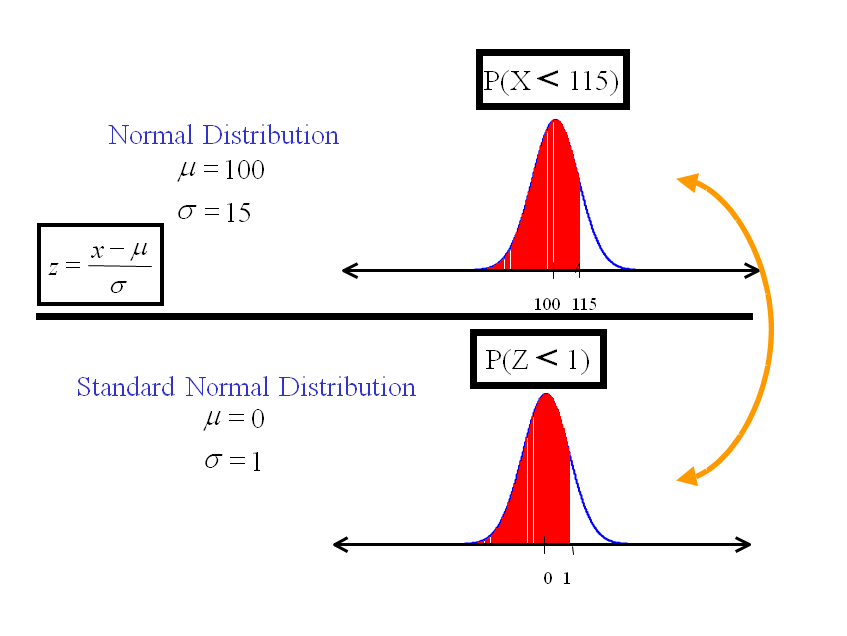

Slide 23
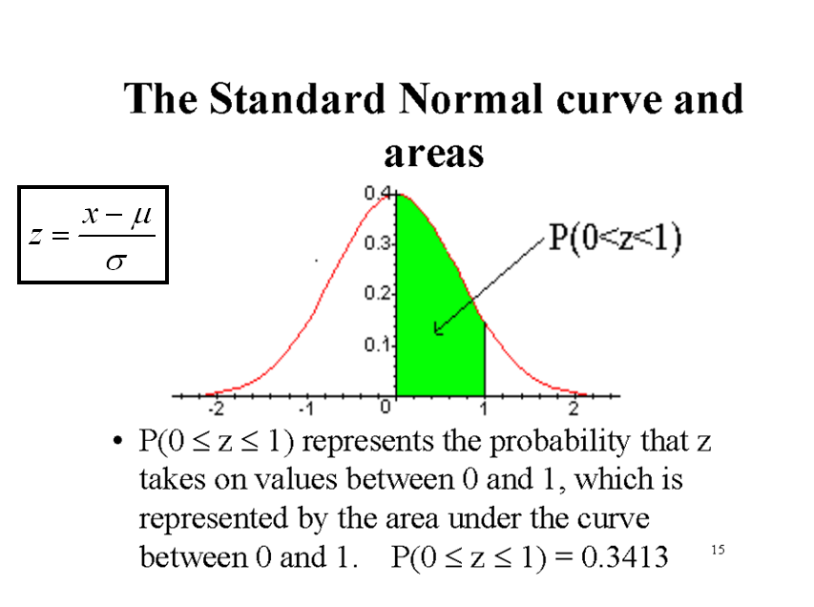

Slide 24
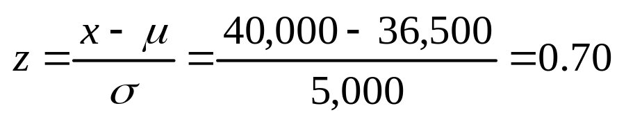
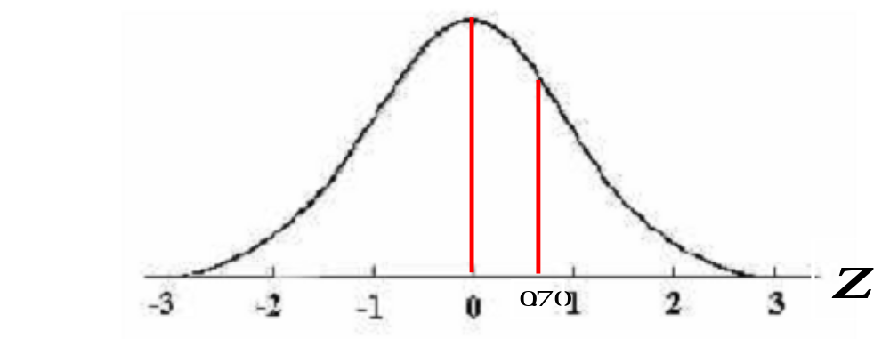
Example: A tire manufacturer estimates the mean tire mileage (life) of a new tire at 36,500 miles, and the standard deviation = 5000 miles. Assuming the life of the tire is normally distributed, what percentage of the tires can be expected to last more than 40,000 miles?
Notes:
EXAMPLES:
A tire manufacturer estimates the mean tire mileage (life) of a new tire at 36,500 miles, and the SD = 5000 miles. Assuming the life of the tire is normally distributed, what percentage of the tires can be expected to last more than 40,000 miles?
Z = (x-mu)/SD = (40,000 - 36,500)/5000 = .7. From P.77 we see that z=.7 corresponds to 25.8%. .5 + .258 = .758. Therefore, 1 - .758 = 24.2% of tires will exceed the 40,000 miles.

Slide 25
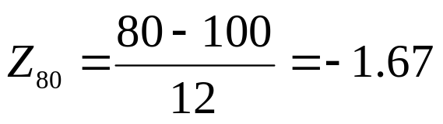
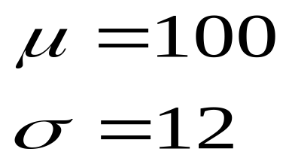
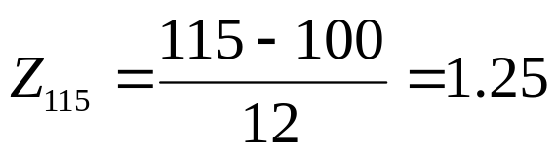
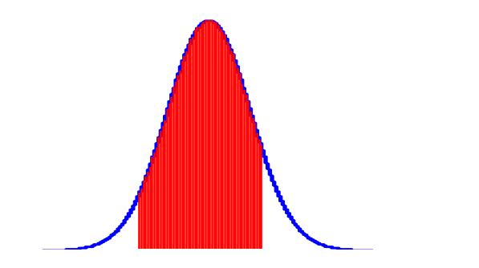
Application
Monthly utility bills in a certain city are normally distributed with a mean of $100 and a standard deviation of $12. A utility bill is randomly selected. Find the probability of selecting a bill between $80 and $115.
Normal Distribution
P(80 < x < 115)
P(-1.67 < z < 1.25)
= 0.8469
The probability a utility bill is between $80 and $115 is 0.8469.
80
115

Slide 26
EXAMPLE
The daily water usage per person in New Providence, New Jersey follows the a normal distribution with a mean of 20 gallons and a standard deviation of 5 gallons. About 68 percent of those living in New Providence will use how many gallons of water?
About 68% of the daily water usage will lie between 15 and 25 gallons.

Slide 27
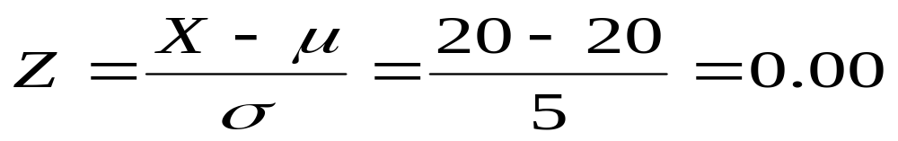

What is the probability that a person from New Providence selected at random will use between 20 and 24 gallons per day?

Slide 28
The area under a normal curve between a z-value of 0 and a z-value of 0.80 is 0.2881.
We conclude that 28.81 percent of the residents use between 20 and 24 gallons of water per day.

Slide 29
